Slide 1

Linux File Descriptor and File I/O Management System
CampusHub – Academic File & Collaboration Portal
Tanya Sri • Roll No: 2520030112 • Department: CSE

Slide 2
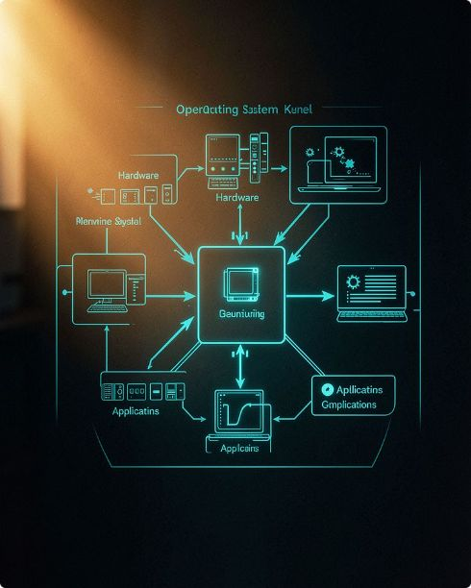






Operating System & File Management — Key Definitions
Operating System — Definition
File Management — Definition
Definition: An Operating System is system software that manages computer hardware and software resources and provides services to application programs.
Purpose: Mediates access to CPU, memory, storage and devices; enforces protection and resource sharing.
CampusHub use: Linux kernel provides file, process and I/O services for the CampusHub C backend.
Definition: File management is the process by which an OS stores, organizes, accesses, modifies and deletes files.
Purpose: Ensures persistence, naming, metadata and permission control for files.
CampusHub use: Stores assignments, submissions and shared notes using Linux filesystem semantics.
Process Management
Memory Management
File & I/O Management
Schedules CampusHub worker processes and handles request concurrency (fork/exec, threads).
Allocates buffers for file I/O, caches pages for read/write performance.
Maps application requests to filesystem operations and file descriptors.
Device Management
I/O Management
Abstracts storage devices; CampusHub accesses files without device-specific code.
Coordinates blocking/non-blocking I/O and buffering for fast, reliable transfers.

Slide 3
What is a File Descriptor?
Definition: A file descriptor is a non‑negative integer used by a Linux process to identify an open file or I/O resource.
Purpose: Acts as a lightweight handle the kernel uses to route read/write operations to the correct file or device.
CampusHub use: Each open assignment or submission corresponds to a file descriptor in the C backend while processing uploads/reads.
Typical flow (viva-friendly):
open() ↓ File Descriptor = 3 ↓ read() / write() ↓ close()
Standard descriptors: 0 = stdin, 1 = stdout, 2 = stderr; 3+ = user files and sockets.
Minimal C example
int fd = open("assignment.txt", O_RDONLY);

Slide 4

What is a System Call & File I/O?
Application
System Call
Linux Kernel
Filesystem
System Call — Definition: A system call is a mechanism through which a user program requests a service from the OS kernel.
Purpose: Provides controlled, privileged access to hardware and kernel-managed resources (files, devices, processes).
CampusHub use: The C backend issues system calls (open, read, write) to persist assignments and handle submissions.
File I/O — Definition: File I/O refers to operations used to read data from files and write data to files.
Why C for backend: C provides direct, predictable bindings to Linux system calls, minimal overhead, and fine control over buffers and file descriptors — ideal for demonstrating OS-level I/O behavior in CampusHub.

Slide 5


Important File I/O System Calls — Definitions & Usage
1
2
3
open()
read()
write()
Definition: Opens or creates a file and returns a file descriptor.
Usage: CampusHub opens assignment and submission files (flags: O_RDONLY, O_WRONLY, O_CREAT).
Definition: Reads data from an open file descriptor into a buffer.
Usage: Read assignment contents for display or grading workflows.
Definition: Writes data from a buffer to an open file descriptor.
Usage: Save student submissions and append shared notes.
4
5
6
close()
lseek()
stat()
Definition: Closes an open file descriptor, releasing kernel resources.
Usage: Ensure descriptors are closed after upload/serve to avoid leaks.
Definition: Changes the current file offset for subsequent reads/writes.
Usage: Implement resumable downloads or random access to large submissions.
Definition: Retrieves file metadata (size, permissions, timestamps).
Usage: Display file info in submission lists and enforce size/deadline checks.
7
8
unlink()
dup()
Definition: Removes a file name from the filesystem (deletes file when no descriptors remain).
Usage: Allow faculty to remove outdated assignments or revoke submissions.
Definition: Creates a duplicate file descriptor referring to the same open file description.
Usage: Redirect logging or temporarily duplicate descriptors for safe concurrent access.

Slide 6
CampusHub System — Definition & Architecture
Definition: CampusHub is an academic file and collaboration portal that demonstrates Linux file-management concepts through practical academic workflows.
Architecture :
Faculty / Student ↓ CampusHub Web Interface ↓ C Backend ↓ Linux System Calls ↓ File Descriptor ↓ Linux Filesystem
Separate Faculty Portal — create, publish, manage assignments
Separate Student Portal — view, submit, replace submissions
Assignment Management — organized storage and metadata via stat()
Student Submissions — file I/O for uploads, replaces, version tracking (future)
Shared Notes — append-only workflows and collaborative files
File I/O Monitoring — basic logging of open/read/write/close events

Slide 7
Faculty and Student Portals — Features
Faculty Portal — Definition & Purpose
Student Portal — Definition & Purpose
Definition: Web interface for instructors to manage course tasks.
Purpose: Publish assignments and review submissions.
Definition: Web interface for students to access coursework and submit work.
Purpose: Submit assignments and access shared materials.
Create assignments (files saved via open+write)
Add descriptions and attach resources
Set deadlines and visibility
View & download student submissions
Manage/remove assignments (unlink())
View assignments (open+read)
Submit assignments (open+write, O_CREAT)
Replace submissions using O_TRUNC
Check submission status and metadata (stat())
Access shared notes (O_APPEND)

Slide 8





File I/O Workflows in CampusHub
Assignment Creation
View Assignment
Student Submission
Replace Submission
open(path, O_WRONLY|O_CREAT) → write(fd, data, n) → close(fd)
Definition: Create and persist assignment file on disk.
CampusHub: Faculty uploads problem statements and resource files using this flow.
open(path, O_RDONLY) → read(fd, buf, n) → close(fd)
Definition: Read file contents for display to users.
CampusHub: Students and faculty preview assignments and resources.
open(path, O_WRONLY|O_CREAT) → write() → close()
Definition: Persist submitted files reliably to storage.
open(path, O_WRONLY|O_TRUNC) → write() → close()
Definition: Truncate existing file then write new content.
Shared Notes
open(path, O_WRONLY|O_APPEND) → write() → close()
Definition: Append new contributions without altering previous content.
These practical workflows map user actions directly to Linux file operations implemented in the CampusHub C backend.

Slide 9
OS Concept Mapping — Feature to System Call
CampusHub Feature | Linux Concept / Syscall
Create Assignment | open() + write()
View Assignment | open() + read()
Submit Assignment | open() + write()
Replace Submission | open(O_TRUNC) + write()
Shared Notes | open(O_APPEND) + write()
File Information | stat()
Delete File | unlink()
File Position | lseek()
Descriptor Duplication | dup()
Action flow (concise): User Action ↓ C Backend ↓ File Descriptor ↓ Linux System Call ↓ Filesystem — a clear chain to explain at viva.

Slide 10
Conclusion & Future Scope
Conclusion: CampusHub demonstrates how OS concepts map to a real application: Linux manages file resources, system calls provide kernel services, file descriptors identify open files, and the C backend ties user actions to filesystem behavior.
Key points to emphasize in viva
Linux manages file resources and grants safe access via system calls.
File descriptors are essential handles for I/O operations.
C exposes direct, low-overhead access to kernel file I/O — ideal for this project.
CampusHub implements real workflows (create, view, submit, replace, append) to illustrate concepts.
Future Scope
File version history and immutable snapshots
Advanced access control & per-file ACLs
File locking (fcntl/flock) for concurrent edits
Database integration for metadata indexing
Real-time collaboration and conflict resolution
Advanced I/O monitoring and audit logs
THANK YOU
Questions & Discussion

